Slide 1
ADFGVX Cipher Implementation
Andrew Helms
12/04/20
Final Project for CIS4362

Slide 2
History
Field cipher used by the German Army in World War 1
Extension of ADFGX
ADFGVX but with a 5x5 grid instead of 6x6
Colonel Fritz Nebel invented it in March of 1918
Developed to provide the army with a more convenient way to encrypt messages than trench codes
Trench codes were often just simple substitution ciphers
Codebooks
Letters A,D,F,G,V, and X were used because they have distinct morse codes relative to eachother
Believed to be unbreakable

Slide 3
Cryptanalysis
Cracked by Lieutenant Georges Painvin of the French Army in April of 1918
Crack relied heavily on statistical analysis which had to be done by hand
Required a large number of messages with stereotyped beginnings
Only effective during times of high traffic
Painvin was able to determine which columns consisted of “top” letters and “side” letters based on the combined frequency distribution of the column’s possible letters
This would result in a transposition of the original message, but cracking this gave the transposition key. This meant that cracking any message with the same transposition key became fairly simple

Slide 4
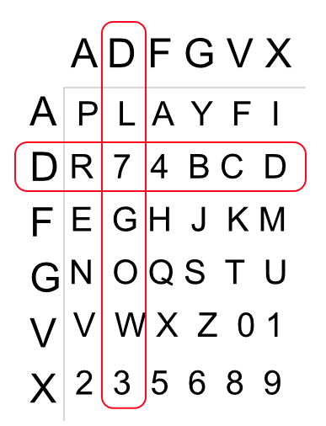
Cryptanalysis (continued)
As you can see in the graphic shown, the characters that correspond to a specific letter in the substitution is dependent on if that letter is the “top” letter or the “side” letter.
This fact allowed Painvin to determine which letters corresponded to rows and which letters corresponded to columns when cracking the columnar transposition part of the ADFGVX cipher.

Slide 5
How it works
Combination of a modified Polybius Square cipher and a key columnar transposition cipher
Grid is 6x6 instead of 5x5
Columns and rows labels as ADFGVX, hence the name
Substitution using the Polybius Square is done first
Output for a letter is two letters. First the letter of the row it is in, then the letter of the column that contains it
Keyed columnar transposition is done next one the output of the Polybius Square
Put message into the matrix by rows, top to bottom
Read output by columns, order dependent on the key. Matrix does not need to be completely filled

Slide 6
How it works (continued)
Two keys
Polybius Square key, not technically required
Since the square is filled with the rest of the alphabet after the key is inserted, not providing the key is the same as providing the ordered alphabet
Keyed Columnar Transposition key, required
The identity key is any key with a length of one
The index of the columns are based on the ordering of the letters in the key
Duplicate characters removed from both keys

Slide 7
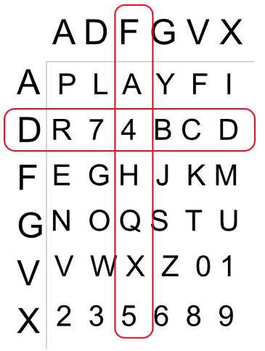
Example: Polybius Square
In this example, the key is PLAYFAIR74. This is reduced to PLAYFIR74 and then inserted into the matrix.
The character being encrypted is ‘4’, which corresponds to the output “DF”

Slide 8
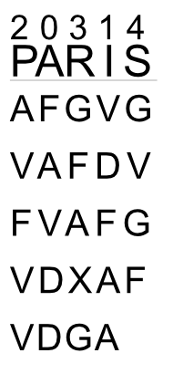
Example: Keyed Columnar Transposition
In this example, the key is “PARIS” with example text: “AFGVG VAFDV FVAFG VDXAF VDGA”
This is the output of the Polybius Square with key “PLAYFAIR74” and plaintext “Attack at dawn”.
The new output would be: “FAVDD VDFAA AVFVV GFAXG AVGF”
This is the example used in the class slides

Slide 9
Implementation
Visual Studios C++ using WINAPI for the GUI
Textboxes for user input/cipher output
Buttons to encrypt/decrypt
All inputs are converted to lowercase and have all non-alphanumeric characters removed
For decryption, all characters that are not in “ADFGVX” are removed
Throws error if the plaintext or the columnar transposition key contains no valid characters
When encrypting, error is sent to the ciphertext output
When decrypting, error is sent to the plaintext output

Slide 10
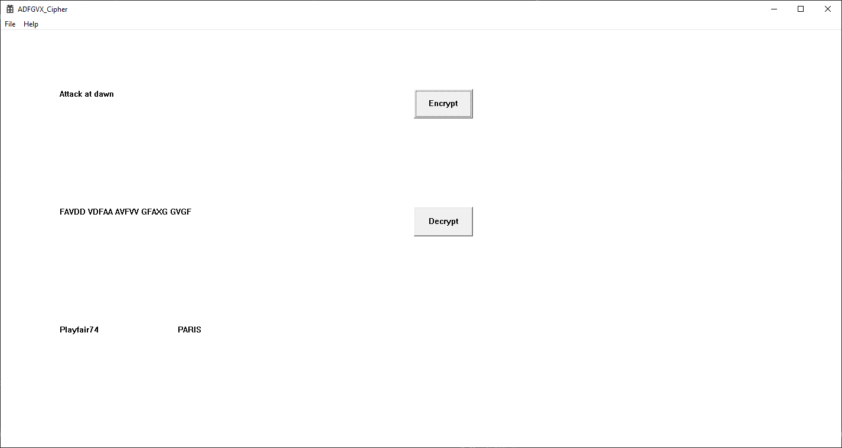
Demo

Slide 11
Testing
Decryption returns original plaintext
Encrypt random string with random keys, decrypt with same keys
Known plaintext, keys, ciphertext combinations
Ex: “Attack at dawn”, “PLAYFAIR74”, “PARIS”, “FAVDD VDFAA AVGVV GFAXG GVGF”
Known invalid plaintexts and columnar transposition key
Empty and only containing non-alphanumeric characters

Slide 12
References:
https://cryptography.fandom.com/wiki/ADFGVX_cipher
https://web.archive.org/web/20100503103848/http://www.vectorsite.net/ttcode_04.html#m3
http://www.practicalcryptography.com/ciphers/adfgvx-cipher/

